Slide 1
CLASSIFICATION & TABULATION
By Dr. Laxmipriya Parida

Slide 2
Classification
The process of arranging the data into group or classes according to resemblances and similarities is technically called Classification.
The presentation of data classified
1. Tabular Representation
2. Graphical and Diagrammatic Representation

Slide 3
Basis or criterion of classification: The data relating to socio-economic enquiry
Eg: classification due to Food, Clothing, Fuel & Lighting, House Rent, Education etc.
Cross-classification: The techniques of dividing the given data into different classes wrt more than one basis simultaneously is called cross-classification.
Eg: University population gender classification again student and faculty classification.

Slide 4
Bases of Classification
Data classified into four bases:
    Geographical- Area-wise or Regional
    Chronological- wrt occurrence of time.
    Qualitative- wrt character or attribute
    Quantitative- wrt numerical values or magnitudes.

Slide 5
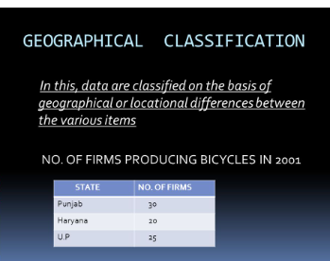

Slide 6
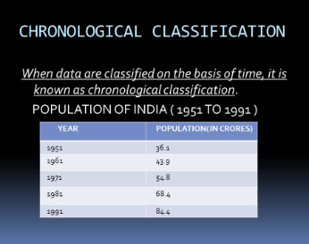

Slide 7
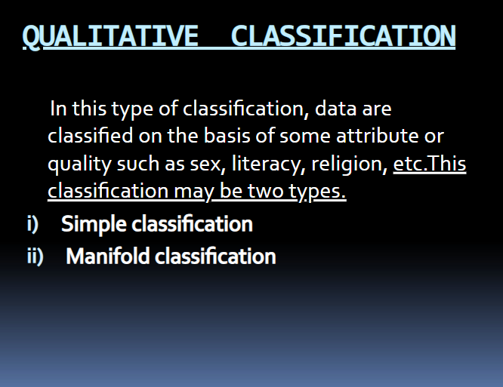

Slide 8
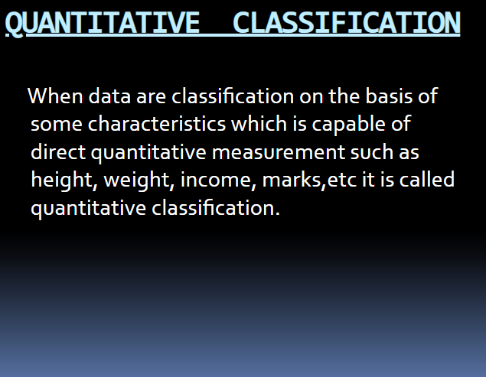

Slide 9
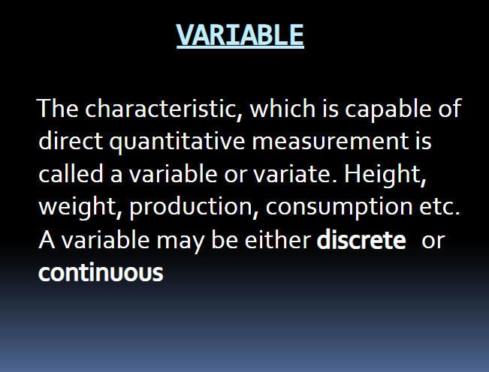
Variable

Slide 10
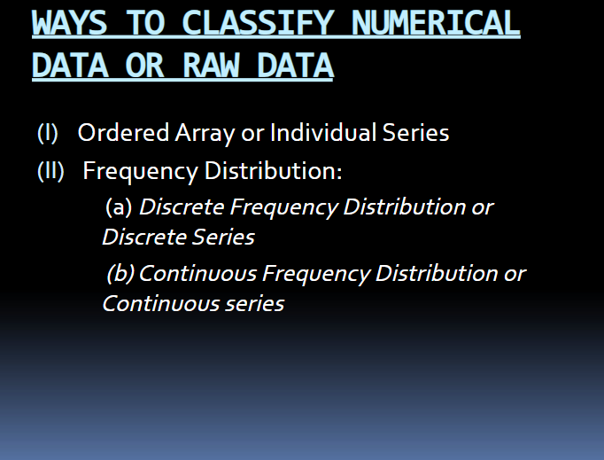

Slide 11
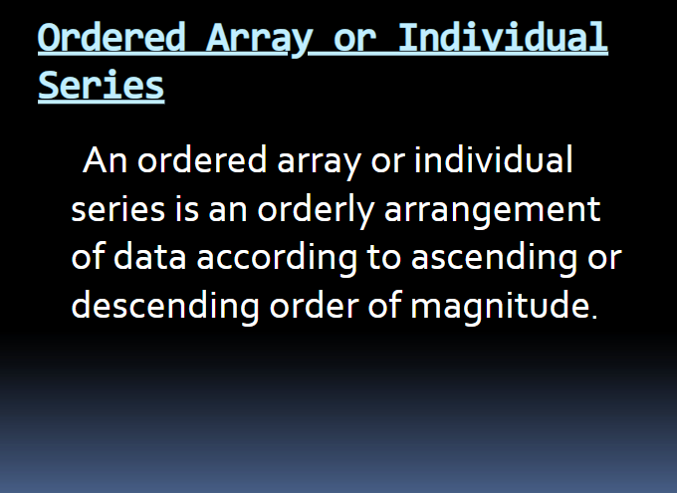

Slide 12
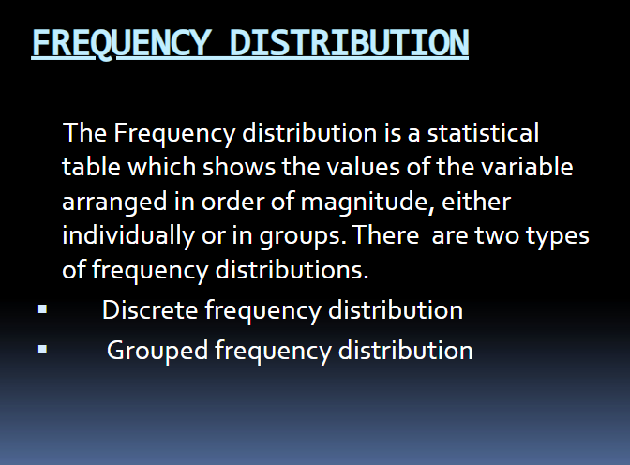

Slide 13
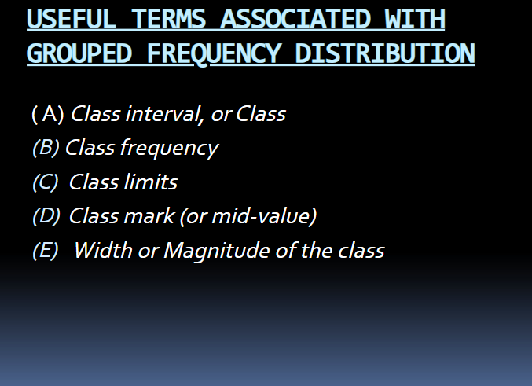

Slide 14


